Slide 1

CSE 473
Pattern Recognition
Lecturer:
Dr. Md. Monirul Islam

Slide 2
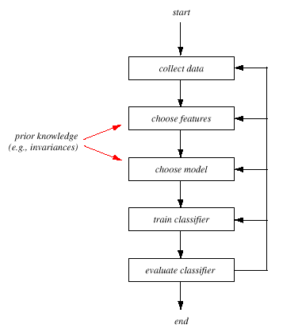
The Design Cycle
Data collection
Feature Choice
Model Choice
Training
Evaluation
Computational Complexity

Slide 3
Data Collection
  How do we know when we have collected an adequately large and representative set of examples for training and testing the system?

Slide 4
Feature Choice
  Depends on the characteristics of the problem domain.
  Requirement
    simple to extract
    invariant to irrelevant transformation
    insensitive to noise.

Slide 5
Model Choice
  too many classification models?
  which one is best?

Slide 6
Training
  Use data to determine the classifier. Many different procedures for training classifiers and choosing models

Slide 7
Evaluation
  Measure the error rate (or performance) and switch from one set of features to another

Slide 8
Computational Complexity
  What is the trade-off between computational ease and performance?

Slide 9
Supervised vs. Unsupervised Learning
Supervised learning
  A teacher provides a category label or cost for each pattern in the training set
Unsupervised learning
  The system forms clusters or “natural groupings” of the input patterns

Slide 10
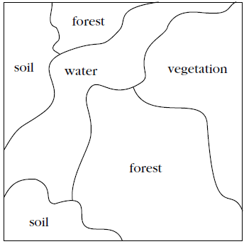

Unsupervised Learning

Slide 11
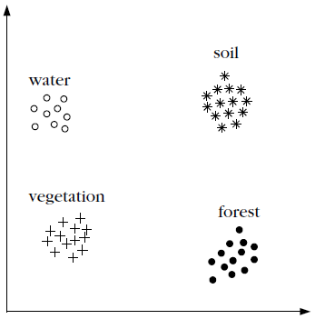
Unsupervised Learning
x₁
x₂

Slide 12
Unsupervised Learning
x₁
3
2
1
2
1
4
4
3
3
2
x₂

Slide 13
Unsupervised Learning
x₁
Forest
Water
Vegetation
Soil
Forest
Soil
x₂

Slide 14
Bayesian Classifier and its Variants

Slide 15
Classification Example 1
Given:
  A doctor knows that meningitis causes stiff neck 50% of the time
  one of every 50,000 persons has meningitis
  one of every 20 persons has stiff neck

Slide 16
Classification Example 1
Given:
  A doctor knows that meningitis causes stiff neck 50% of the time
  one of every 50,000 persons has meningitis
  one of every 20 persons has stiff neck
If a patient has stiff neck, does he/she has meningitis?

Slide 17
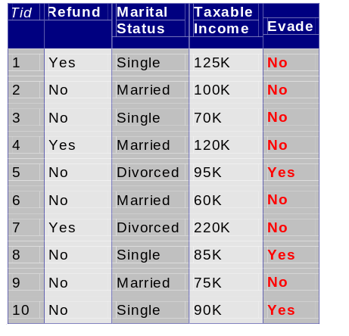
Classification Example 2

Slide 18
Classification Example 2
A married person with income 100K did not refund the loan previously

Slide 19
Classification Example 2
A married person with income 100K did not refund the loan previously
Can we trust him?

Slide 20
Classification Example 3
The sea bass/salmon example
  We know the previous counts of salmon/sea bass
  Can we predict which fish is coming in the conveyor?

Slide 21
Bayes Classifier
A probabilistic framework for solving classification problems
Bayes theorem:

Slide 22
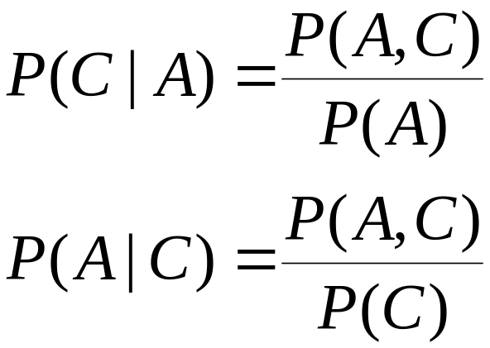
Bayes Classifier
A probabilistic framework for solving classification problems
Conditional Probabilities:

Slide 23
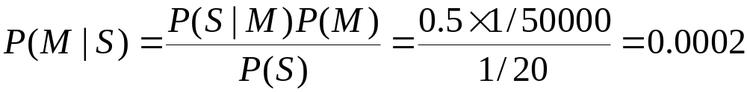
Example 1
Given:
  A doctor knows that meningitis causes stiff neck 50% of the time
  Prior probability of any patient having meningitis is 1/50,000
  Prior probability of any patient having stiff neck is 1/20
If a patient has stiff neck, does he/she has meningitis?

Slide 24
Example 3
The sea bass/salmon example
  We know the previous counts of salmon/sea bass
    amount of catches
    class or state of nature (Salmon/Sea bass)
    state of nature is a random variable

Slide 25
Example 3
The sea bass/salmon example
    if the catch of salmon and sea bass is equi-probable
      P(ω₁) = P(ω₂) (uniform priors)
      P(ω₁) + P( ω₂) = 1 (exclusivity and exhaustivity)

Slide 26
Decision rule with only the prior information
  Decide ω₁ if P(ω₁) > P(ω₂) otherwise decide ω₂

Slide 27
Decision rule with only the prior information
  Decide ω₁ if P(ω₁) > P(ω₂) otherwise decide ω₂
  Misclassify many fishes

Slide 28
Use of the class –conditional information
  Use lightness
P(x | ω₁) and P(x | ω₂) describe lightness in sea bass and salmon

Slide 29
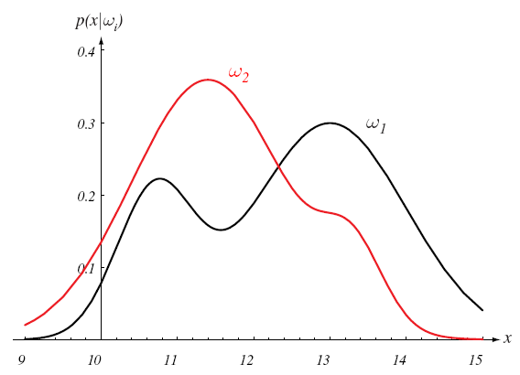
Lightness

Slide 30
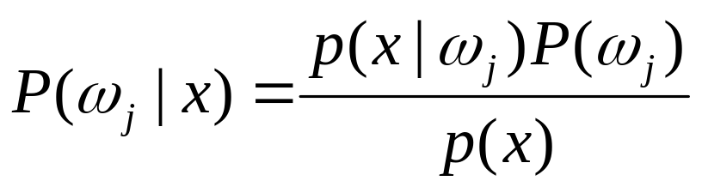
Given the lightness evidence x, calculate Posterior from Likelihood and evidence
  Posterior = (Likelihood. Prior) / Evidence

Slide 31

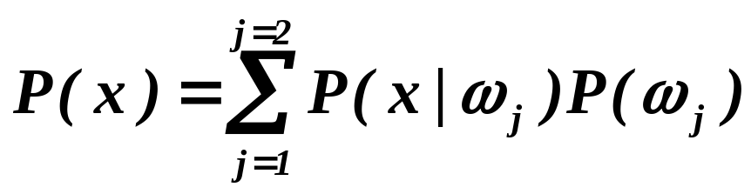
Given the lightness evidence x, calculate Posterior from Likelihood and evidence
  where in case of two categories

Slide 32
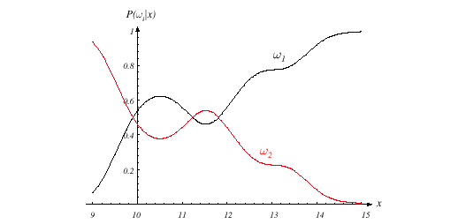
Posterior function

Slide 33
Decision given the posterior probabilities
X is an observation for which:
if P(ω₁ | x) > P(ω₂ | x) True state of nature = ω₁
if P(ω₁ | x) < P(ω₂ | x) True state of nature = ω₂

Slide 34
Decision given the posterior probabilities
X is an observation for which:
if P(ω₁ | x) > P(ω₂ | x) True state of nature = ω₁
if P(ω₁ | x) < P(ω₂ | x) True state of nature = ω₂
Therefore:
whenever we observe a particular x, the probability of error is :
P(error | x) = P(ω₁ | x) if we decide ω₂
P(error | x) = P(ω₂ | x) if we decide ω₁

Slide 35
Minimizing the probability of error
Decide ω₁ if P(ω₁ | x) > P(ω₂ | x);
otherwise decide ω₂
Therefore:
P(error | x) = min [P(ω₁ | x), P(ω₂ | x)]
(Bayes decision)

Slide 36
Bayesian Decision Theory – Continuous Features
Generalization of the preceding ideas
  Use of more than one feature
  Use more than two states of nature
  Allowing actions and not only decide on the state of nature
  Introduce a loss of function which is more general than the probability of error

Slide 37
Classification to Minimize Loss
Let {ω₁, ω₂,…, ω_{m}} be the set of m states of nature
(or “categories or classes”)
Let {α₁, α₂,…, α_{n}} be the set of possible actions
Let λ(α_{i} | ω_{j}) be the loss incurred for taking
action α_{i} when the state of nature is ω_{j}

Slide 38
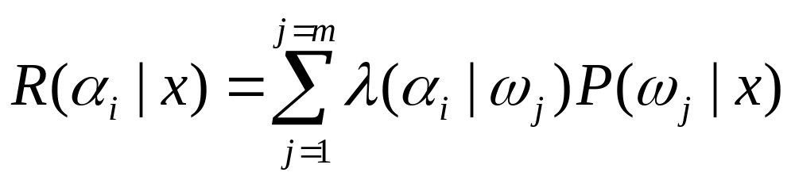
Classification to Minimize Loss
The risk to take decision α_{i} is
Overall risk
R = Sum of all R(α_{i} | x) for i = 1,…,n
Minimizing R Minimizing R(α_{i} | x) for i = 1,…, n

Slide 39
Classification to Minimize Loss
Two-category classification
    α₁ : deciding ω₁
    α₂ : deciding ω₂

Slide 40
Classification to Minimize Loss
Two-category classification
    α₁ : deciding ω₁
    α₂ : deciding ω₂
    λ_{ij} = λ(α_{i} | ω_{j})
loss incurred for deciding ω_{i} when the true state of nature is ω_{j}

Slide 41
Classification to Minimize Loss
Two-category classification
    α₁ : deciding ω₁
    α₂ : deciding ω₂
    λ_{ij} = λ(α_{i} | ω_{j})
loss incurred for deciding ω_{i} when the true state of nature is ω_{j}
Conditional risk:
R(α₁ | x) = λ₁₁P(ω₁ | x) + λ₁₂P(ω₂ | x)
R(α₂ | x) = λ₂₁P(ω₁ | x) + λ₂₂P(ω₂ | x)

Slide 42
Classification to Minimize Loss
Our rule is the following:
if R(α₁ | x) < R(α₂ | x)
action α₁: “decide ω₁” is taken

Slide 43
Classification to Minimize Loss
Our rule is the following:
if R(α₁ | x) < R(α₂ | x)
action α₁: “decide ω₁” is taken
Now use these formula:
R(α₁ | x) = λ₁₁P(ω₁ | x) + λ₁₂P(ω₂ | x)
R(α₂ | x) = λ₂₁P(ω₁ | x) + λ₂₂P(ω₂ | x)

Slide 44
Classification to Minimize Loss
Our rule is the following:
if R(α₁ | x) < R(α₂ | x)
action α₁: “decide ω₁” is taken
This results in the equivalent rule :
decide ω₁ if:
(λ₂₁- λ₁₁) P(x | ω₁) P(ω₁) >
(λ₁₂- λ₂₂) P(x | ω₂) P(ω₂)
and decide ω₂ otherwise

Slide 45
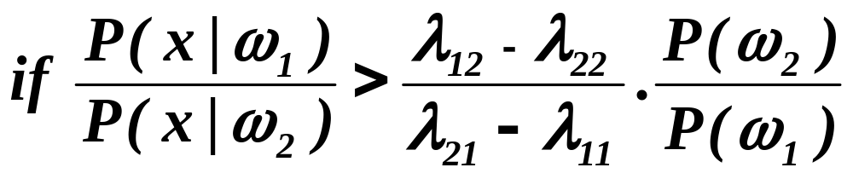
Classification to Minimize Loss
The preceding rule
(λ₂₁- λ₁₁) P(x | ω₁) P(ω₁) >
(λ₁₂- λ₂₂) P(x | ω₂) P(ω₂)
is equivalent to the following rule:
Then take action α₁ (decide ω₁)
Otherwise take action α₂ (decide ω₂)

Slide 46
Classification to Minimize Loss
Likelihood ratio:
The preceding rule
(λ₂₁- λ₁₁) P(x | ω₁) P(ω₁) >
(λ₁₂- λ₂₂) P(x | ω₂) P(ω₂)
is equivalent to the following rule:
Likelihood ratio
Then take action α₁ (decide ω₁)
Otherwise take action α₂ (decide ω₂)

Slide 47
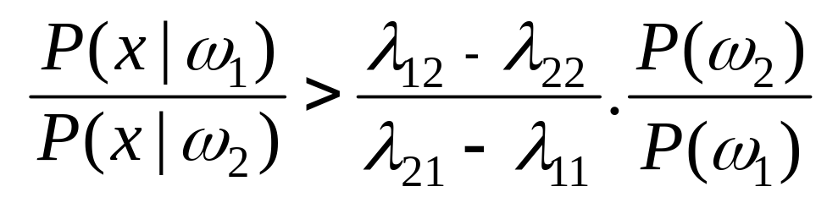
Classification to Minimize Loss
Optimal decision property
“If the likelihood ratio exceeds a threshold value independent of the input pattern x, we can take optimal actions”

Slide 48

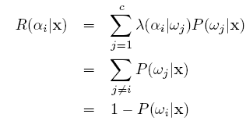
Minimum Error Rate Classification
Assume the loss function for two class case:
The Risk is now:

Slide 49
Minimum Error Rate Classification
Assume the loss function for two class case:
The Risk is now:
Minimizing R Minimizing R(α_{i} | x) Maximizing P(ω_{i} | x)

Slide 50
Minimum Error Rate Classification
Our rule was:
if R(α₁ | x) < R(α₂ | x)
action α₁: “decide ω₁” is taken
which is equivalent to:

